Slide 1


MANAGEMENT COMMITTEE REVIEW
MONTHLY DEPARTMENTAL PERFORMANCE REVIEW
COVERED PERIOD: JUNE TO AUGUST
PRESENTED BY: ERIS ALYANA O. BUENAVENTURA
AUGUST 17, 2026

Slide 2

OBJECTIVES
Present status and progress of IT projects and systems.
Review completed, ongoing, and pending initiatives.
Identify issues, risks, and project bottlenecks.
Highlight IT contributions to operational efficiency.
Present project costs, timelines, and resource need.
Request management guidance and approvals on key items.

Slide 3
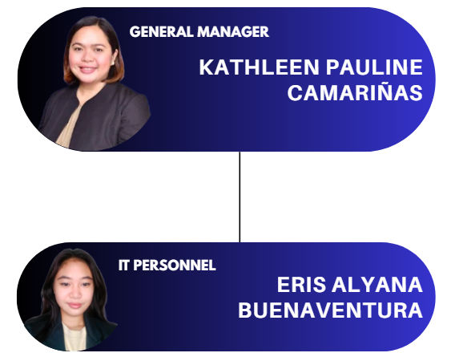
ORGANIZATIONAL
CHART

Slide 4
IT DEPARTMENT
OVERVIEW
Department Function
Responsible for the company’s IT systems, infrastructure, and digital project implementation to support business operations.
Manpower Status
IT Personnel: 1 (Solo IT Support) and End-to-end IT operations (development, maintenance, support, deployment)
Key Responsibilities
Technical support for all departments
Current Workload Summary
Completed Projects: 6
Ongoing Projects: 3
On Hold Projects: 2
Not Started Projects: 2

Slide 5
MONTHLY
HIGHLIGHTS
Item | Status | Impact
EAMS App and Management | Completed (100%) | Improves operational monitoring, management, and process efficiency
Company Printer | Completed (100%) | Supports daily office operations and document processing requirements
Canva, GDrive, and Zoom Implementation | Completed (100%) | Improves collaboration, file management, communication, and productivity
Company Jacket | Completed (100%) | Strengthened company branding and professional appearance.
3 Render ID Design For SP | Ongoing (80%) | Provides updated ID designs for management approval and implementation
2 Render ID Design For Poly | Ongoing (30%) | Prepares ID design for Poly implementation, pending SP advisory/approval
Backup/Archive Files | Ongoing (1%) | Supports data protection, file recovery, and organized records management
Canary Biometric Internet Connection | Not Started (0%) | Planned to improve biometric connectivity, data transmission, and system reliability

Slide 6
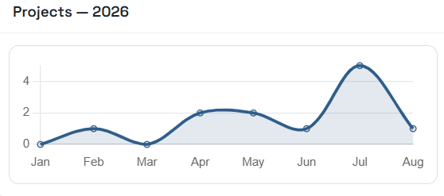
IT PROJECT PERFORMANCE
DASHBOARD
Status | Count | Remarks
Completed | 7 | Successfully delivered
Ongoing | 3 | Progressing as planned
On Hold | 2 | Awaiting approval for continuation
Not Started | 2 | Scheduled and awaiting approval to start

Slide 7
DEPARTMENT
CONTRIBUTION
Project | Contribution
Shared Calendar | Easier scheduling and coordination
Calling Card | Professional calling cards for leads
Company Printer | Supports all department printing needs
Canva/GDrive/Zoom | Helps with collaboration and file sharing
EAMS App | Easier employee attendance monitoring
Canary Biometric | Stable internet connection for biometric access
Backup/Archive Files | Keeps important files backed up and organized
Saveplus ID Card Design | Updated ID design for Saveplus
Saveplus Jacket | Company jackets for Saveplus admin

Slide 8
ISSUES/CONCERNS/ BOTTLENECKS
Issue | Root Cause | Affected Department | Required Action | Escalation Needed
LinisPlus project on hold | Source code technical issues | IT | Evaluate project viability and determine next steps | Management Decision
Printer Toner | Printer toner cost | All Department | Refill or purchase original toner | Management Decision

Slide 9
ACTION PLANS AND PROPOSALS
Action Item | Responsible Person | Timeline | Success Measure
Implement Canary Biometric wired connectivity | IT | August 2026 | Stable internet connection for biometric access
Establish data storage and backup process | Management/IT | 2026 | Company files properly backed up and organized
Coordinate with SP Management regarding LinisPlus | Management / IT | 2026 | Clear project direction and status confirmed
Continue IT project monitoring and support | IT | Ongoing | Projects are monitored and progress is properly tracked
Improve project tracking and transition monitoring through ITPMS | IT | Ongoing | Project updates, status, and progress are properly monitored: https://itpms.infinityfreeapp.com/index.php

Slide 10
THANK YOU

